Slide 1
Lecture
ON
Hashing
V.Radhesyam
Assistant professor
Department of IT:VRSEC

Slide 2
Introduction
The Essence of hashing is to facilitate the next level searching method when compared using linear/binary search.
Hashing can take constant time O(1)
Amount of time to perform the operation does not depend on data size n
Linear search O(n),Binary search (log₂n)

Slide 3
Data Structure
Hash table is a Data Structure used to implement associate array.
Assume that we have set of Integers 54, 26, 93, 17, 77 & 31
Remainder method (example hash function)
h(data) = data%11
These values are to be inserted in hash table
0 1 2 3 4 5 6 7 8 9 10
Data | h
54 | 10
26 | 4
93 | 5
17 | 6
77 | 0
31 | 9
Data
Hash Function
Location of the data in the hash table.

Slide 4
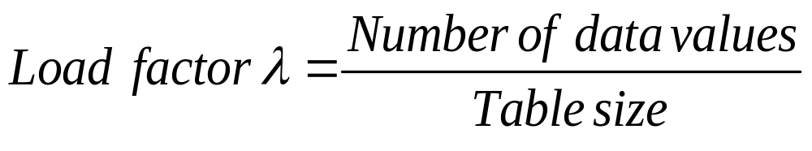
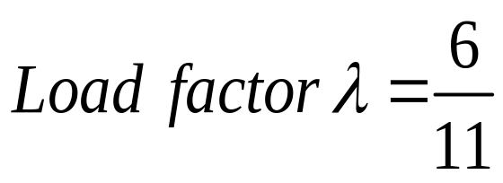
Load factor
77 |  |  |  | 26 | 93 | 17 |  |  | 31 | 54
0 1 2 3 4 5 6 7 8 9 10
When two data values are hashed to two similar location in a hash table then collision occurs.
Then it must be placed in alternate location.
These methods are called collision resolution techniques.

Slide 5
Collision resolution Techniques
Separate chaining
Open addressing
  Linear probing
  Quadratic probing
  Double hashing
Rehashing
Extendable hashing.
Best course of action:
separate chaining: if the number of records is not known in advance
open addressing: if the number of the records can be predicted and there is enough memory available

Slide 6
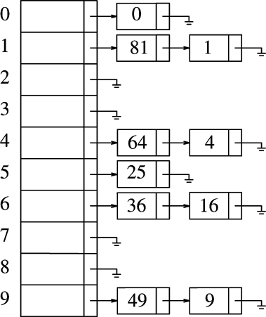
Separate chaining
Consider the data
0,1,4,9,16,25,36,49,64,81
Hash function
H(X)=X mod 10
Each table entry stores a list of
Items. So the problem of multiple
keys mapped to same entry can
be Solved.
This need pointer, which makes
algorithm slow.

Slide 7
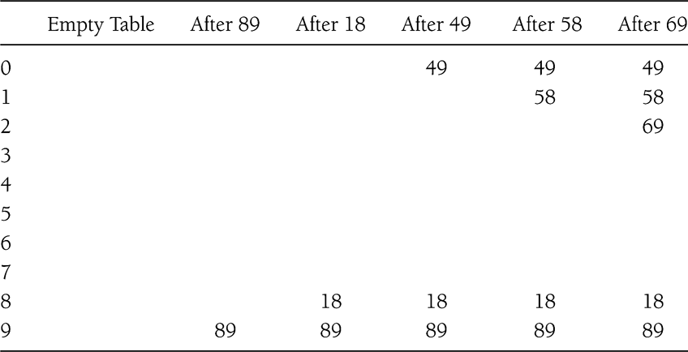
Linear probing
H(X)=X mod 10
Insert 89, 18, 49, 58, 69

Slide 8
Linear probing
First collision occurs with 49
It is placed in next available location that is 0 which is open
58 colloids with 18,89 and then 49
69 can also be handled similarly
F(i)=i is the strategy followed
Any key that hashes into the cluster will require several attempts to resolve the collision. This is called primary clustering.

Slide 9

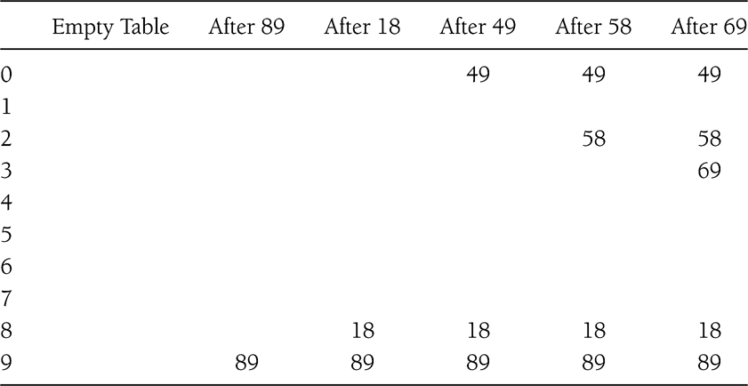
Quadratic Probing
1
2
2
3
3
4
4
1

Slide 10
Quadratic probing
Quadratic probing solves the problem of primary clustering.
F(i)=i² is the strategy followed
When 49 collides with 89, the next position attempted is one cell away. This cell is empty, so 49 is placed there.
58 collides at 8 in the next location(9) another collision occurs.
2²=4 so 58 is placed in cell 2
Same thing happened for 69
Limitation: at most half of the table can be used as alternative locations to resolve collisions.(secondary clustering)

Slide 11
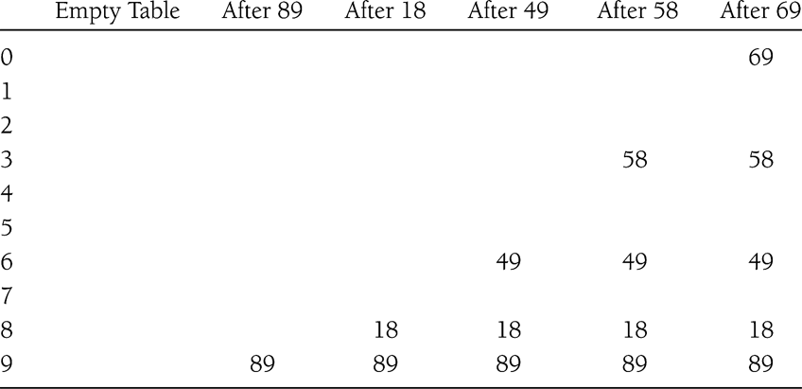
Double hashing
Hash function hash₂(x) = R – (x % R)
Where R is prime number smaller than table size(7)

Slide 12
Double hashing
First collision occurs when 49 is inserted
hash₂(49) = 7 – (49 % 7)=7 so 49 is inserted at position 6
58 inserted at position 3
hash₂(69)=1
hash₂(60)=3
Double hashing is the most efficient collision technique, when the size of the table is prime number and it avoids clustering.

Slide 13
Re hashing
Hash Table may get full
  No more insertions possible
Hash table may get too full
  Insertions, deletions, search take longer time
Solution: Rehash
  Build another table that is twice as big and has a new hash function
  Move all elements from smaller table to bigger table

Slide 14
Re hashing
If table gets too full, the running time for the operations will take long time and insert may fail using open addressing.
A solution is to build another table that is twice as big that original table and map data values using new hash function.
This entire process is called rehashing.
Rehashing is very expensive
Rehash can be done in following cases
  If insertion fails
  When table is half full
  Reaches certain load factor

Slide 15
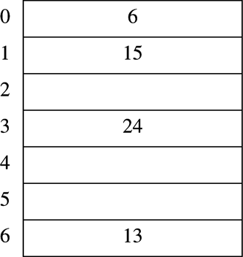
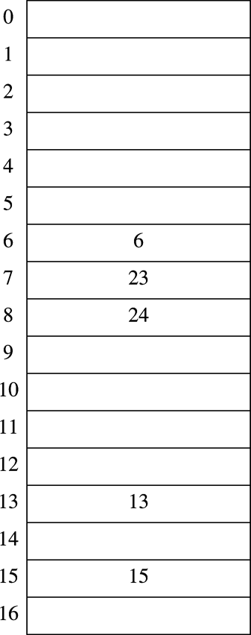
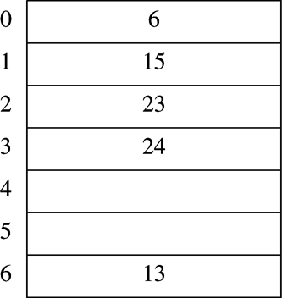
Re hashing
Data: 13,15,24 and 6
Table size:7
H(x)=xmod7
Original Hash Table
First prime number twice as large than old table size is 17
New has function
H(x)=xmod17
After Rehashing table is like below
After 23 is Inserted :70% of table is full

Slide 16
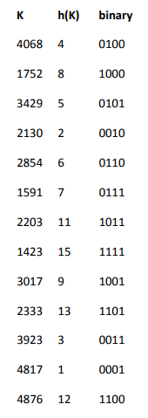
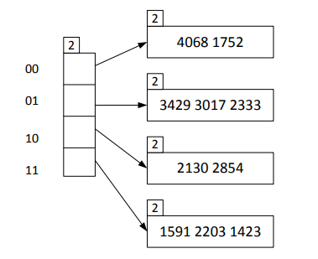
Extendable hashing
We start by having a directory with 4 slots and 4 data blocks in the hash file. Each block has space for three keys.
The key 4068 has hash value 4 (decimal) or 0100 (binary). The directory is indexed by the two last digits of the binary number. Thus, the key 4068 is hashed to block 0.
After inserting the first 10 records we get the following hash file:
h(K) = K MOD 16

Slide 17
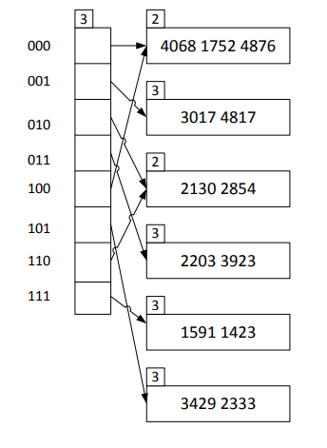
Extendable hashing
The number 2 attached to both the directory and the data blocks tell that we have used two bits in the hashing.
When inserting the 11th record (3923) we get a directory doubling.
After inserting all 13 records we get this structure:

Slide 18
Extendable hashing
After the directory doubling we use three bits for the hashing when inserting new records and when splitting existing blocks. We do the splitting by using the bits from the right, meaning the three last bits
The insert of the key 3923 results in a block split. Thus the keys in this block (11) are rehashed to two blocks (011 and 111). Thus 1591 and 1423 are moved to 111, while the new key 3923 ends in 011 together with the existing key 2203.
Similarly for the key 4817, it results in a split of block 01 to 001 and 101. Note that blocks that are unsplit retain their attached number, i.e. the local depth. The number attached to the directory is named global depth.
When a block is full and we try to insert a new key and the local depth for the block equals the global depth, we get a directory doubling.
Extendible hashing is regarded as a good solution to dynamic hash files. However, the directory results in two accesses to the hash file instead of one as in the normal case in static hashing.

Slide 19
Thank You

